Slide 1
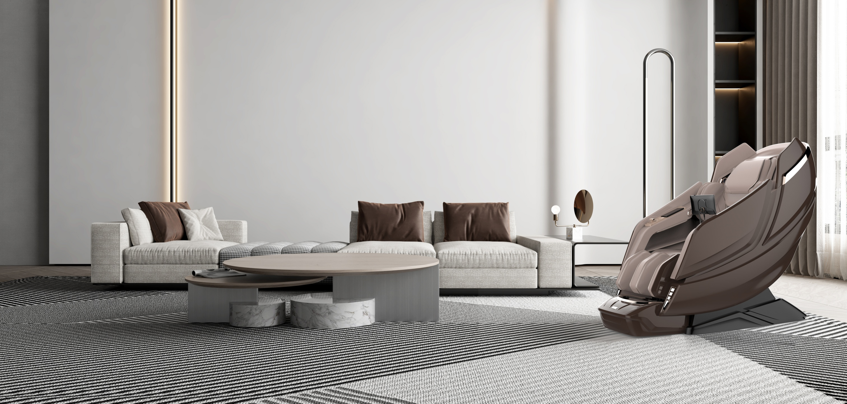

Luxury Massage Chair
A128

Slide 2
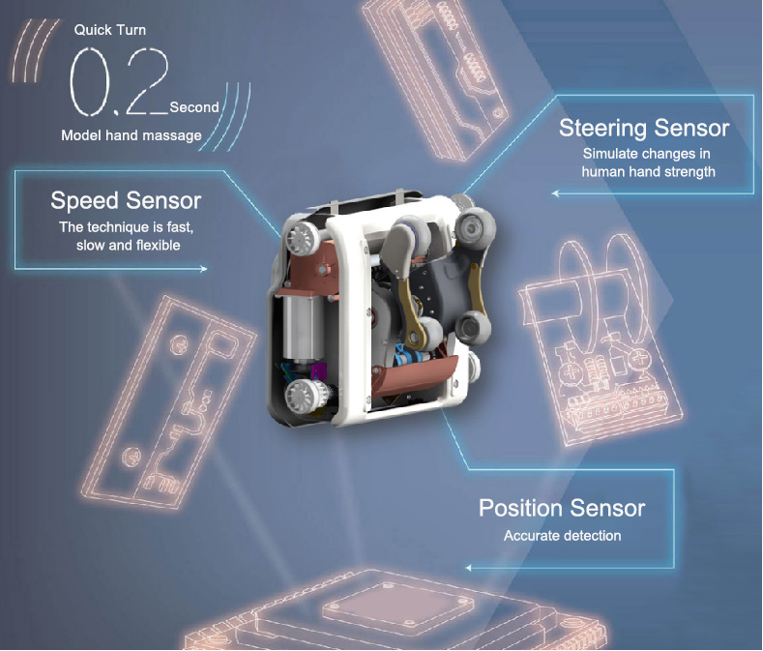
A128
MASSAGE CHAIR
4D Motion Sensing Movement
Achieve Multi-dimensional
Massage Experience
Equipped with a 4D motion sensor and an 8-core sensor, it achieves multi-dimensional precise control of force, speed, position, and temperature.

Slide 3
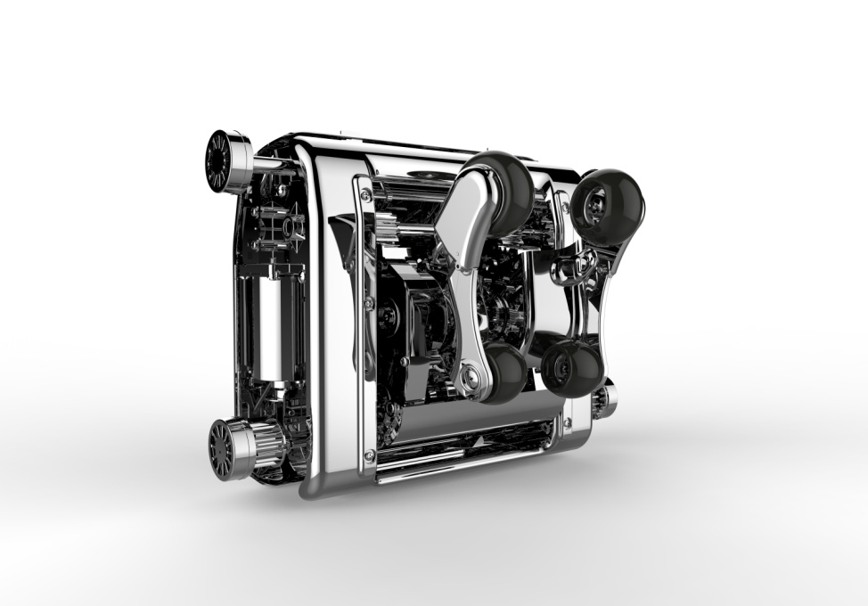
A128
1. Simulate Human Massage Track
Infrared Detection of Position and Speed
1. Realize control of position with a resolution of 1mm and find precise massage acupoints.
2. Realize ultra wide range control of massage speed of 15cm/s-1cm/s, allowing for massage
Diversified techniques, fast and slow with ease.
3. AI algorithms enable different users to enjoy the same physical therapy techniques.
2. Massage Intensity Feedback
Real time monitoring of massage intensity (accuracy of 0.1kg-0.2kg); Make massage techniques intelligent and anthropomorphic.
3. Sensor
Speed sensor - flexible changes in technique speed
Pressure sensor - simulating changes in human hand force
Position sensor - accurately detecting partial changes
MASSAGE CHAIR

Slide 4
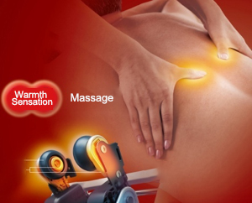
A128
MASSAGE CHAIR
Movement Massage Wheel Heating
Wandering heating Heating more comprehensive
The movement massage wheel heats up as warm as a human hand,
The temperature is controllable, and the massage wheel is pressed onto that part of the body,
Warmth there, the hot compress area is more comprehensive and comfortable.

Slide 5
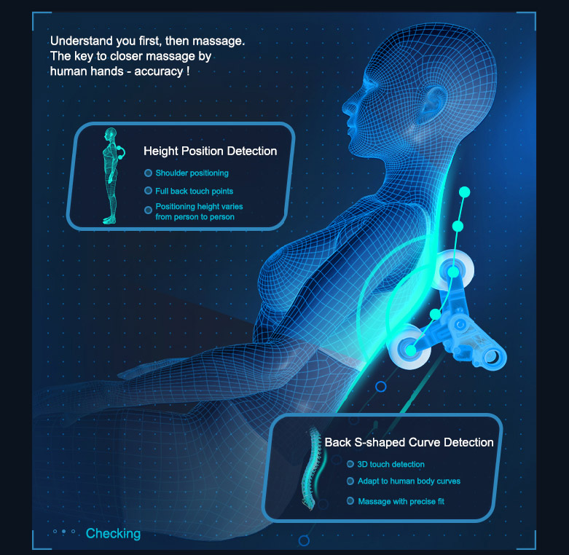
A128
MASSAGE CHAIR
Intelligently Detecting Dtixifferent Body Types
Massage Program Accurately Matches Height and Body Shape
Intelligent sensing of shoulder position and body shape curve changes through dual detection technology, automatically adapting to different body shapes, making massage more accurate
Functional embodiment:
Height position detection:
Combining shoulder pressure positioning with full back sampling,positioning height massage
Backbone curve detection:
3D tactile detection, adapting to changes in human body curves, providing more precise and fitting massage

Slide 6
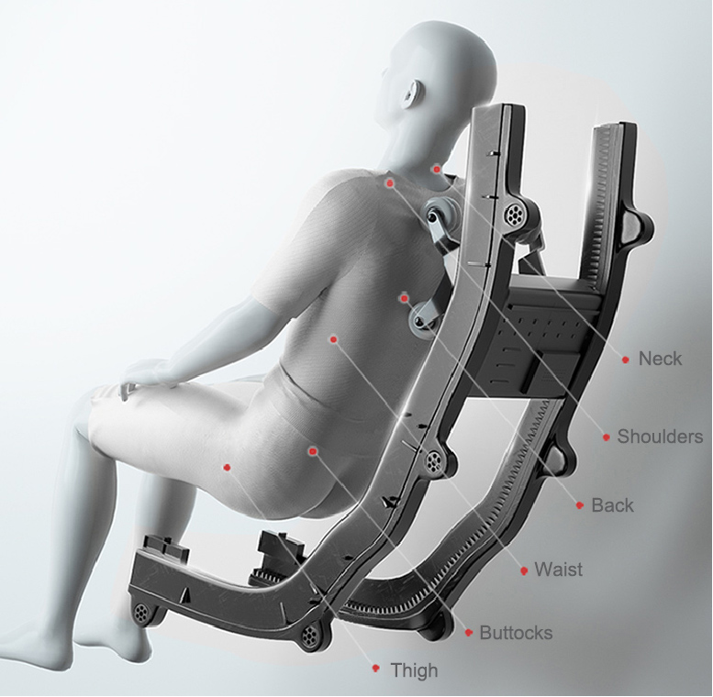
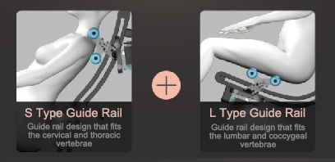
A128
MASSAGE CHAIR
Extended 130cm SL Rail
New SL type long guide rail, smooth guide rail design,
precise fitting of human body curves and reduced movement
movement movement Noise, 6-stage massage for neck, shoulders,
back, waist, buttocks, thighs, carpet style full coverage massage.

Slide 7
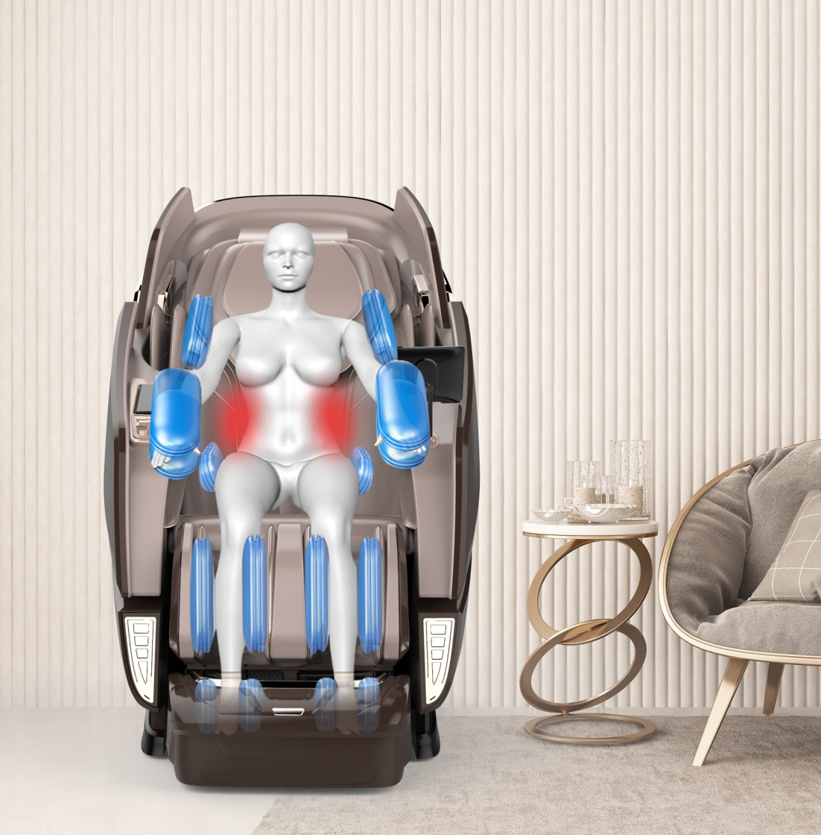
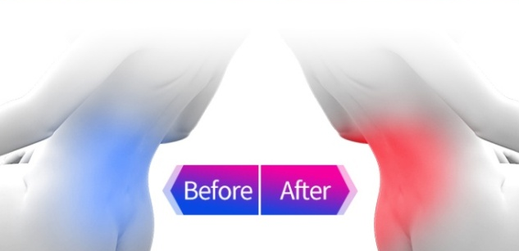
A128
MASSAGE CHAIR
Airbag compression, Care with Love
Shoulders, arms, seat side, leg side, foot side, and ankle are gently and tightly protected by full body airbags.
Multi level force adjustment.
Hot compress on the waist
45 ° intelligent temperature control, combined with waist and back massage, accelerates blood circulation in the waist and back, effectively relieving back pain.

Slide 8
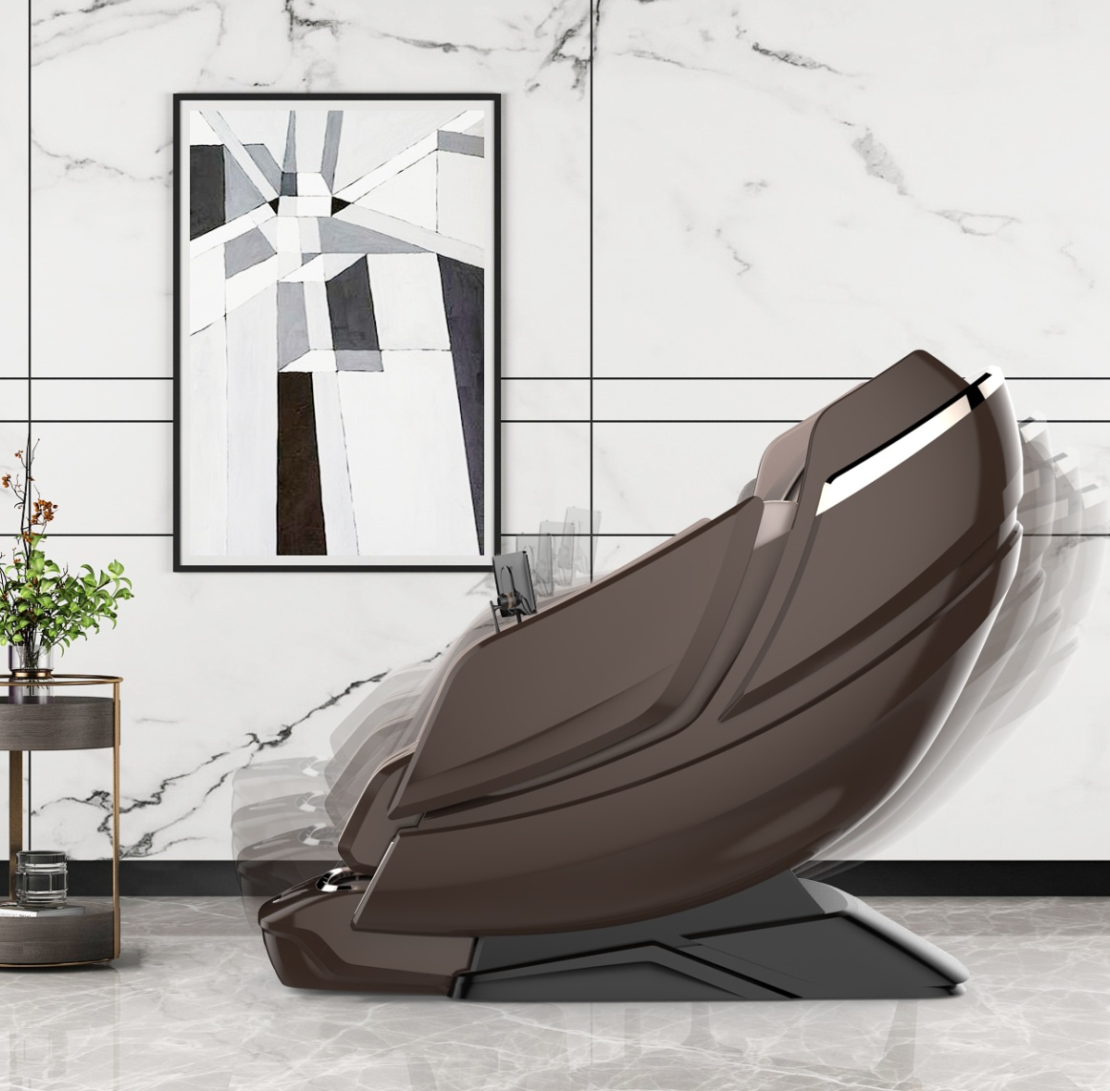
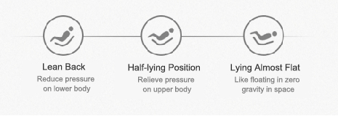
A128
MASSAGE CHAIR
Zero Gravity with One Click
Zero gravity creates a completely relaxed, natural, and comfortable massage posture, allowing the back and legs to simultaneously tilt at zero pressure and in a spacecraft style tilt state, thus enjoying the pleasure of zero gravity massage.

Slide 9
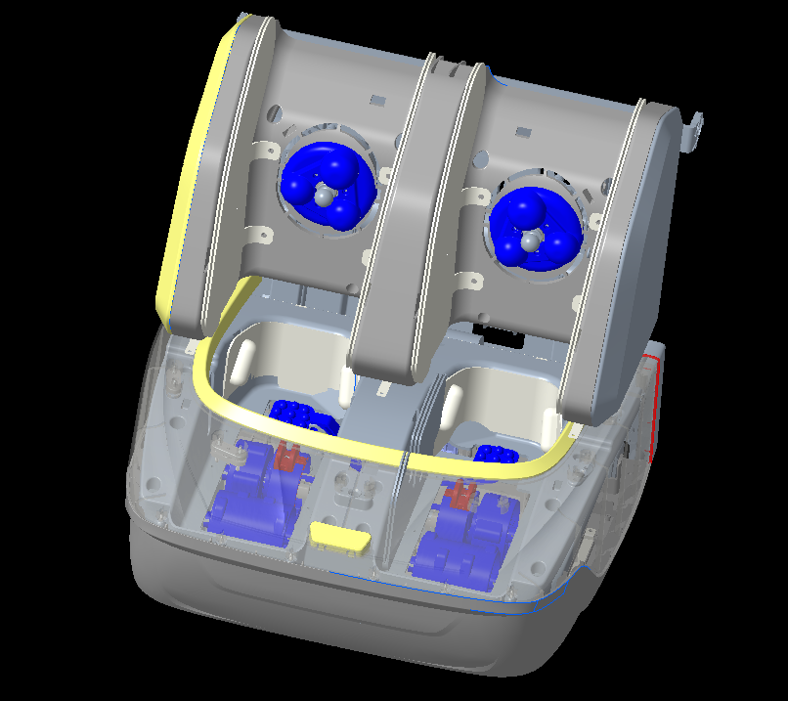
A128
MASSAGE CHAIR
Leg Massage
--- the Key to Improve Comfort
The A128 massage chair enhances the comfort of leg massage by using airbags, foot rollers, and leg hot compress:
1. Kneading the legs and stomach: By kneading the legs and stomach, adjust the body's qi and blood, and relieve leg and foot fatigue.
2. Sole tapping: effectively relieves foot muscle fatigue.
3. Double row roller massage on the soles of the feet: Multiple pressure balls on the soles of the feet stimulate acupoints, injecting new vitality into
your feet.

Slide 10
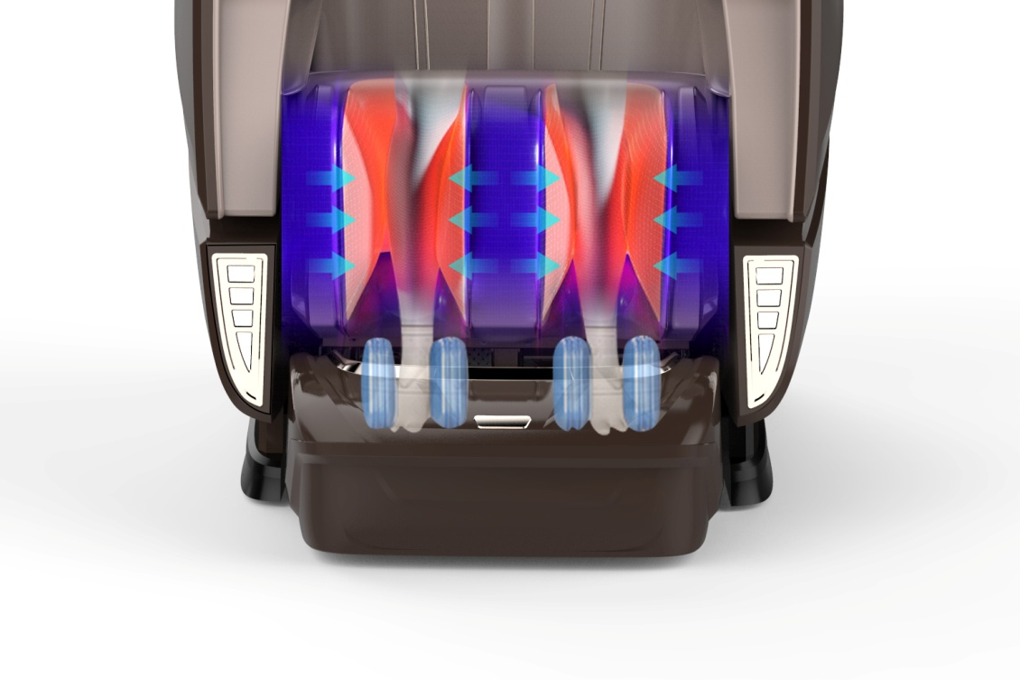
A128
MASSAGE CHAIR
Warm Therapy Promotes Blood Circulation
Calf hot compress, continuously heated to a stable state not
exceeding 44 ℃, allowing users to enjoy a warm atmosphere
while avoiding burns.
Benefits of heating: softening muscles, dilating blood vessels,
and promoting blood circulation

Slide 11
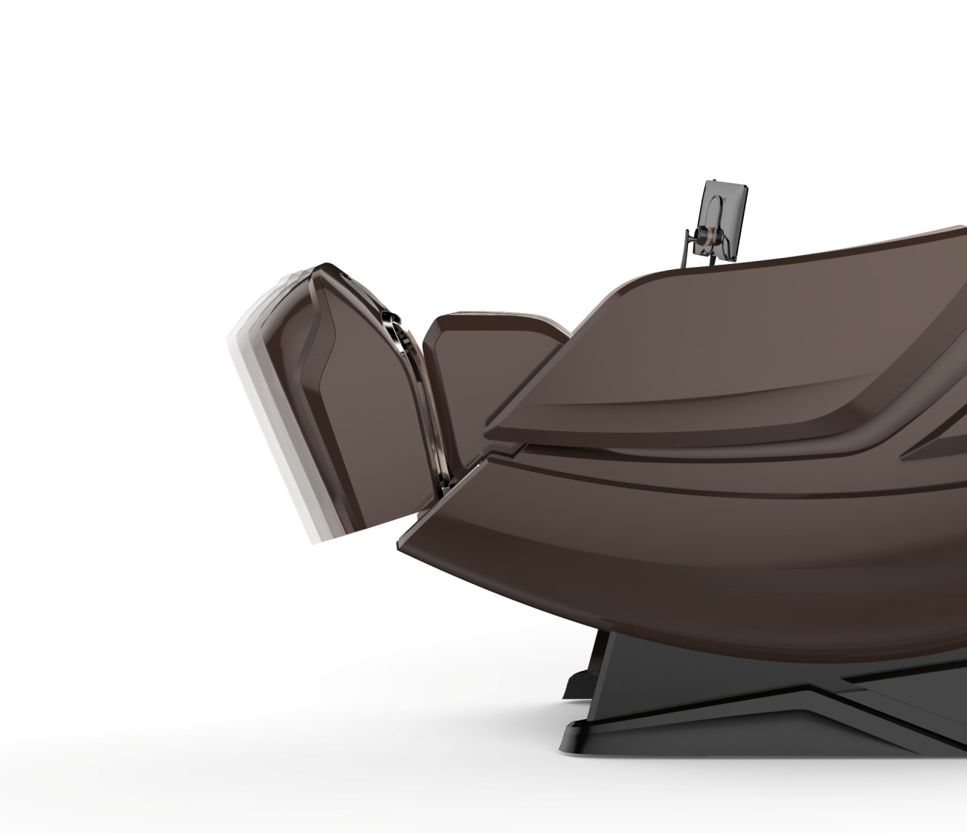
A128
MASSAGE CHAIR
Electric telescopic Adjustment, for Different Boday Shape
Lower limb massage is a key area for improving the comfort of massage chairs. The A128 massage chair uses electric telescopic calves, which automatically "find feet" and accurately locate according to the user's different heights, effectively improving massage efficiency. The legs can be electrically retracted by 15CM, supporting people of different heights.
Electric leg extension and contraction

Slide 12
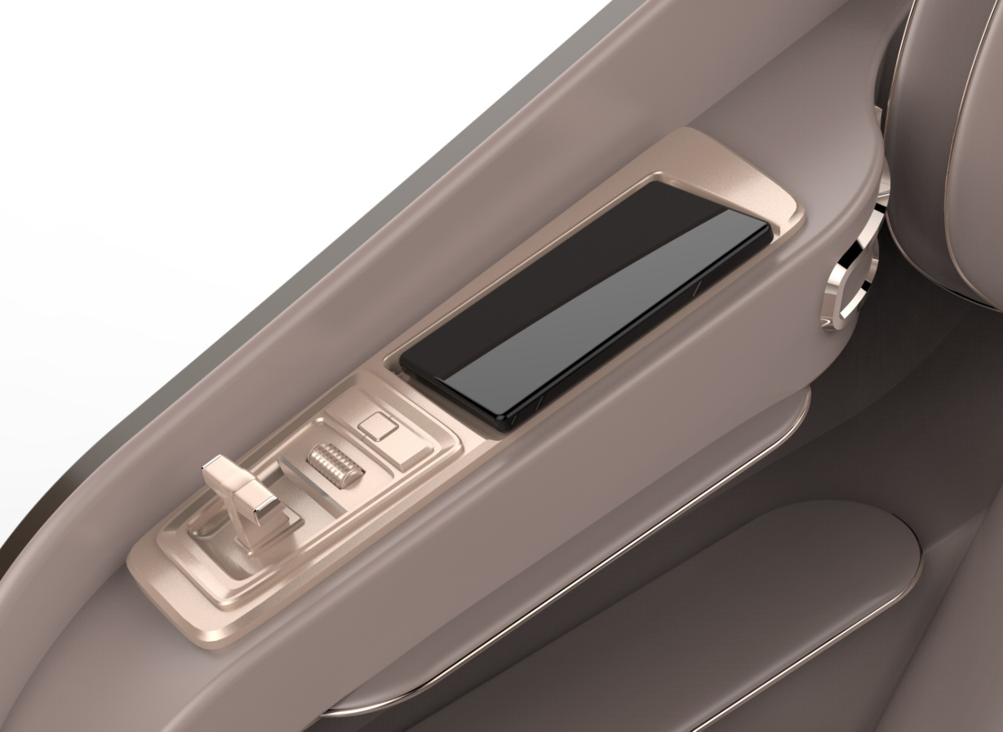
A128
MASSAGE CHAIR
Car Style Shortcut Key
Design of car center console
Unique handling experience
Zero gravity up and down adjustment lever,
roller forward and backward adjustment, stepless
lifting of leg crane

Slide 13
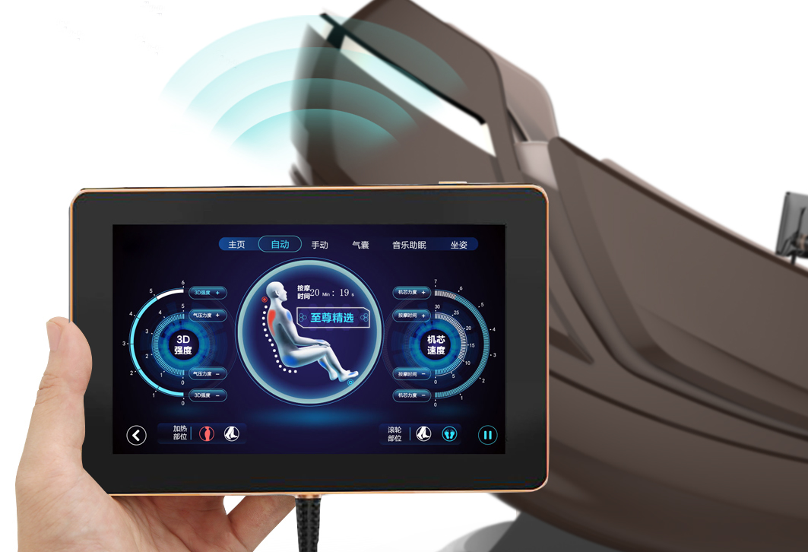
A128
MASSAGE CHAIR
Ultra Thin Touch Screen Display
Redefining luxury massage chairs and deeply adjusting the manual controls, suitable for all ages.
One click touch, high-definition LCD screen, simple operation

Slide 14
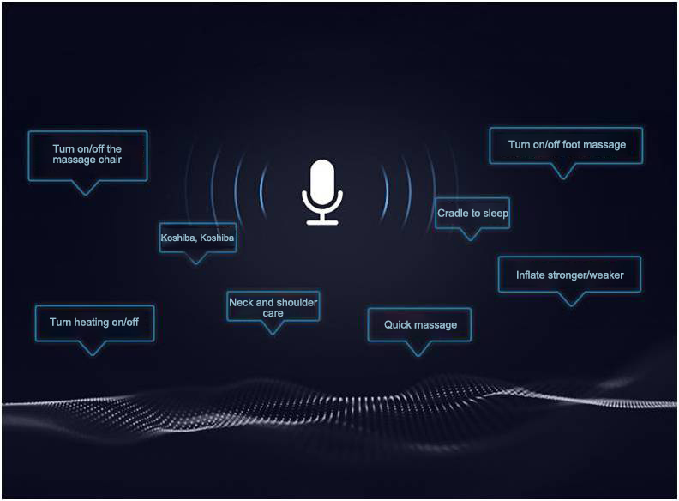
A128
MASSAGE CHAIR
Intelligent AI Voice
Your voice is the remote control
Short answer instructions can be used to achieve massage chairs through intelligent AI voice systems
Interacting with users frees up hands.

Slide 15
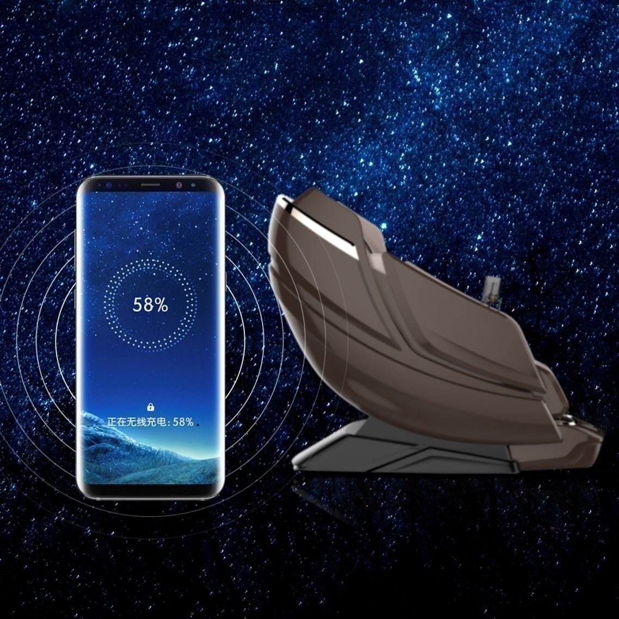

A128
MASSAGE CHAIR
Wireless Charge
Energy is transmitted between the charger and the electrical device through a magnetic field, avoiding exposed wires and ensuring safety.
Users can place their phones with wireless charging function in the card slot and charge and extend their phone anytime, anywhere.

Slide 16
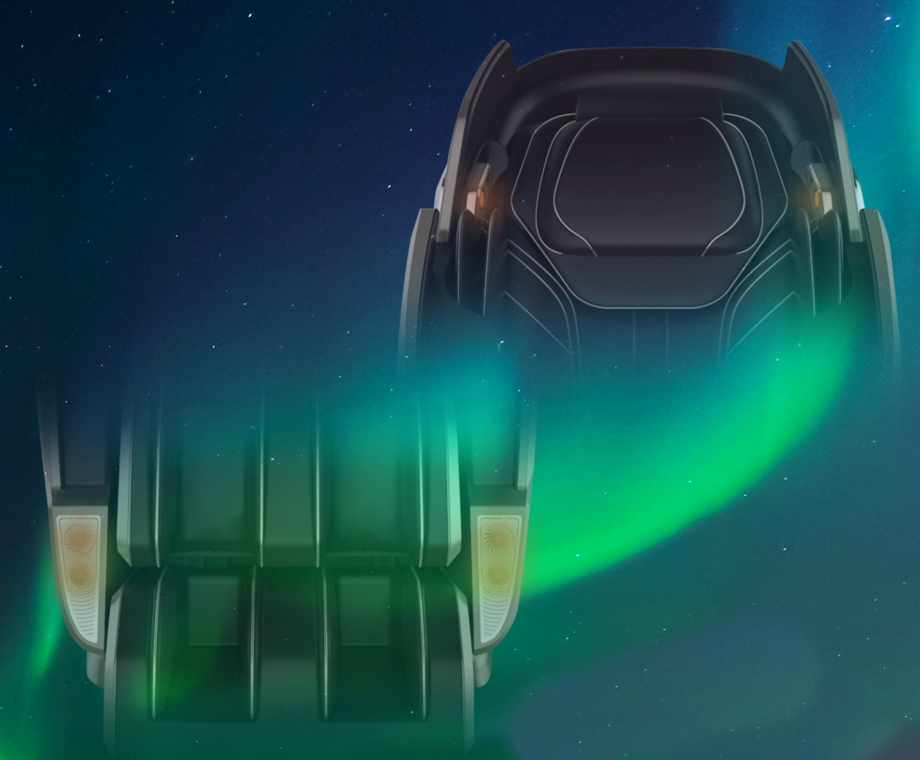
A128
MASSAGE CHAIR
Front-end Decoration + Ambient light
The massage chair that gives radiance shines with a dazzling ice blue light strip in the dark night

Slide 17



A128
MASSAGE CHAIR
Immersive Music Massage Experience
The massage chair head cover is equipped with a high fidelity three-dimensional Bluetooth speaker on both sides, providing surround music for you to enjoy while massaging, creating a comfortable massage atmosphere and allowing you to feel comfortable and relaxed throughout your body and mind.

Slide 18
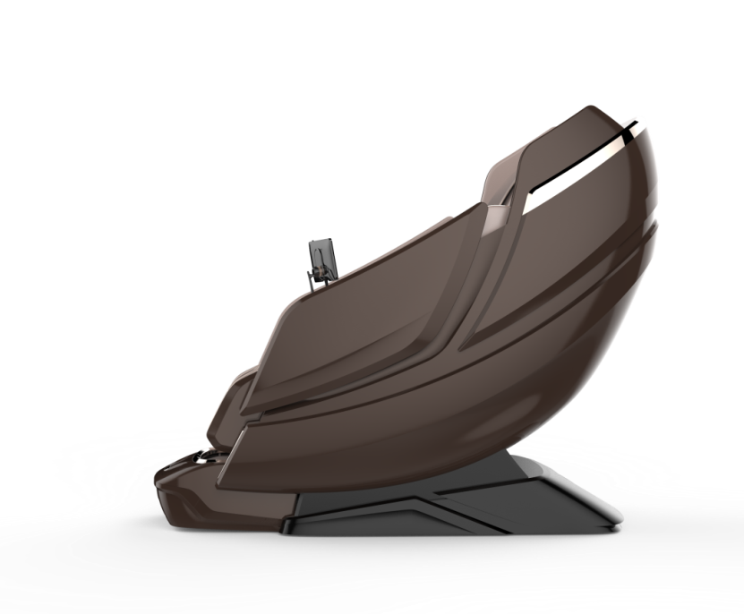
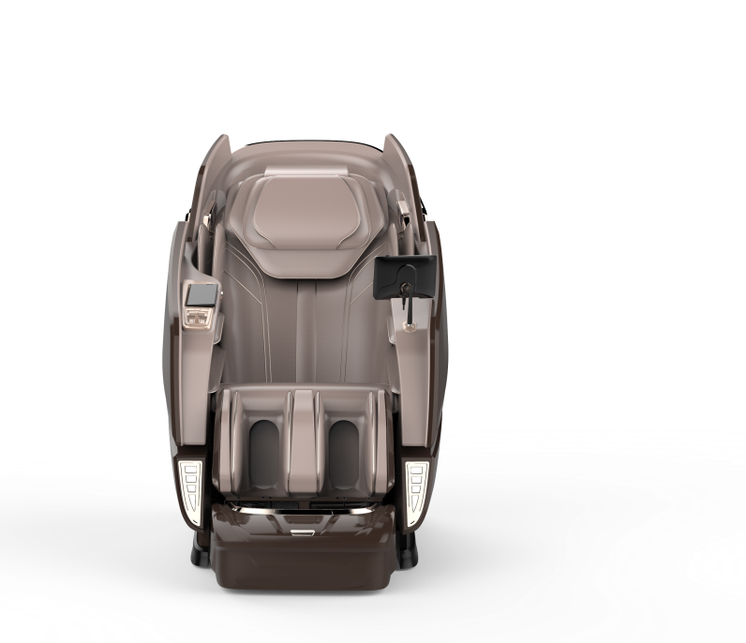
A128
MASSAGE CHAIR
【Product Parameters】
1315mm
Model: A128
Rated frequency: 50Hz
Rated voltage: 220V~
Rated power: 200W
Vertical size: 1640 * 875 * 1315mm
1640mm
875mm

Slide 19
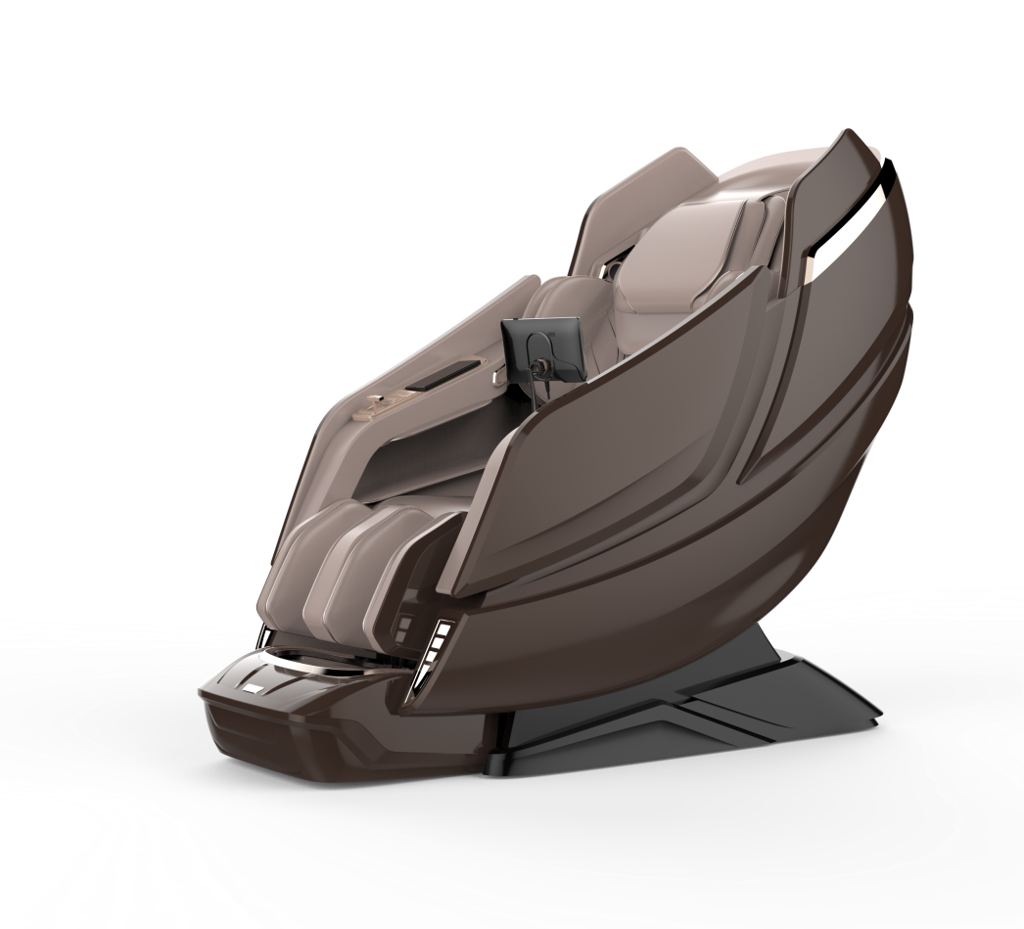

A128
MASSAGE CHAIR

Slide 20
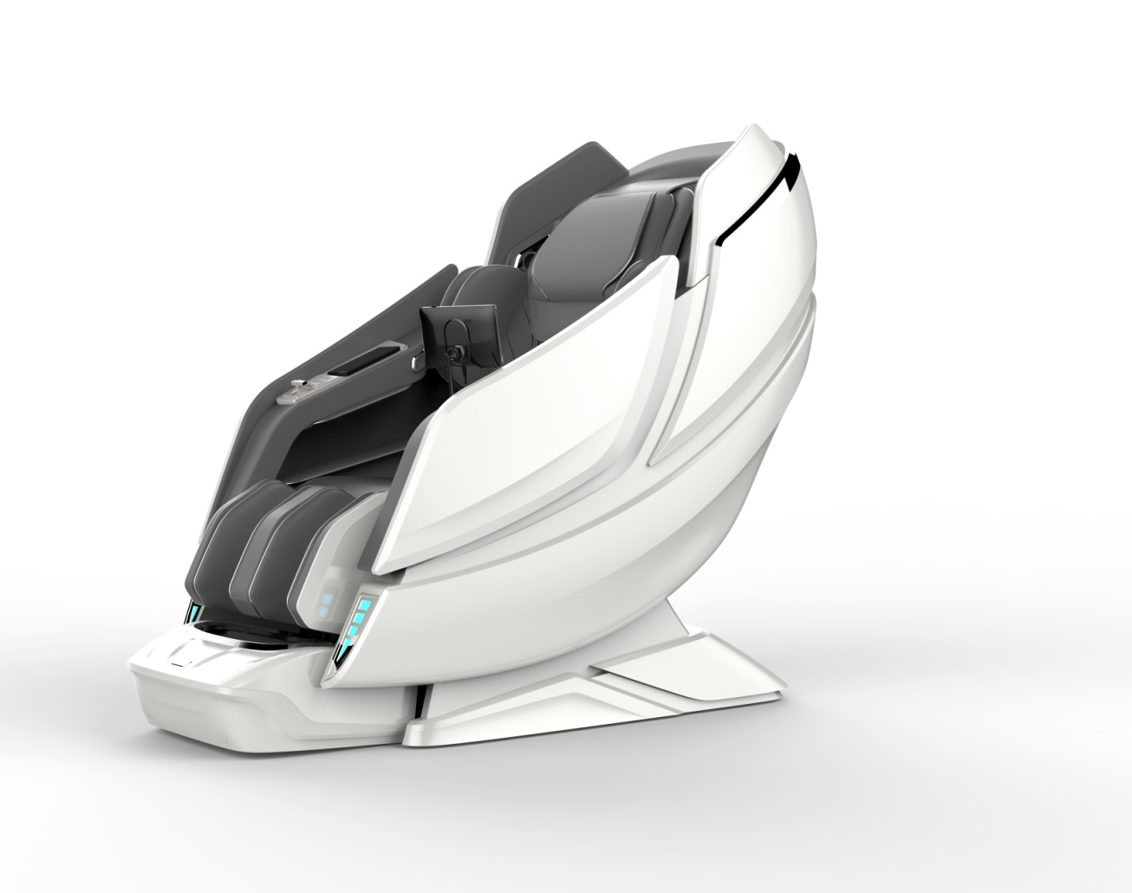
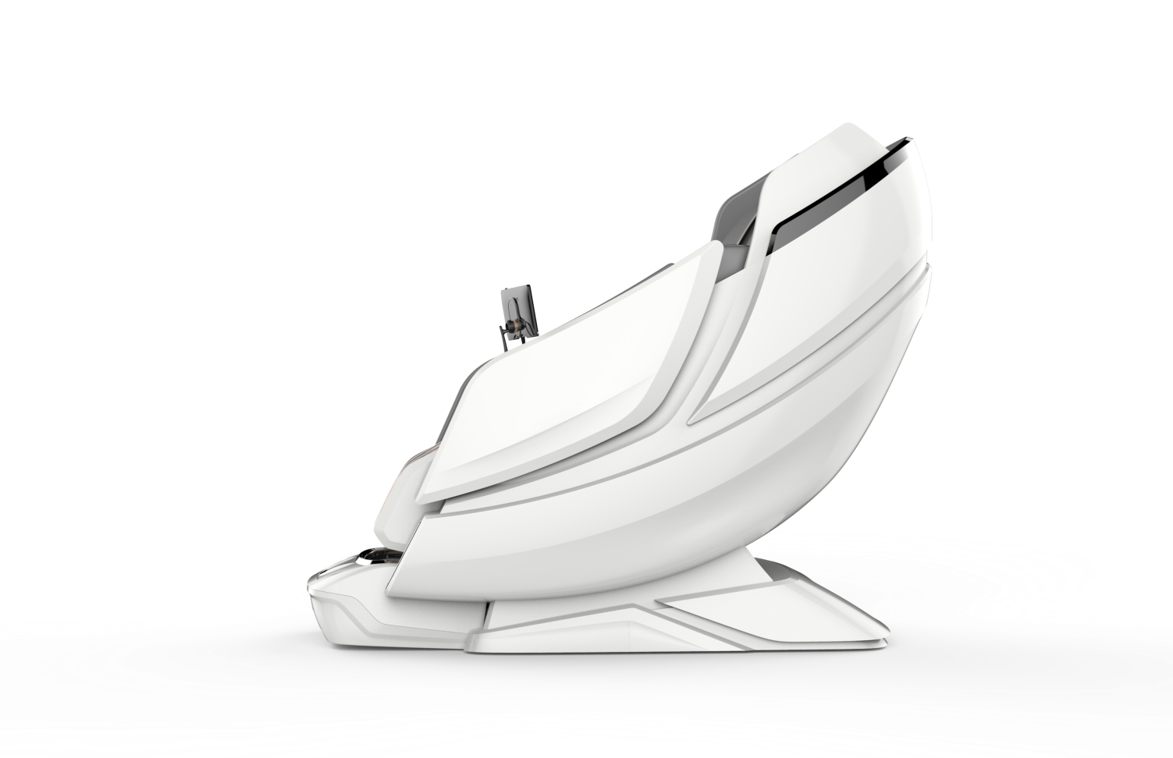
A128
MASSAGE CHAIR

